Slide 1
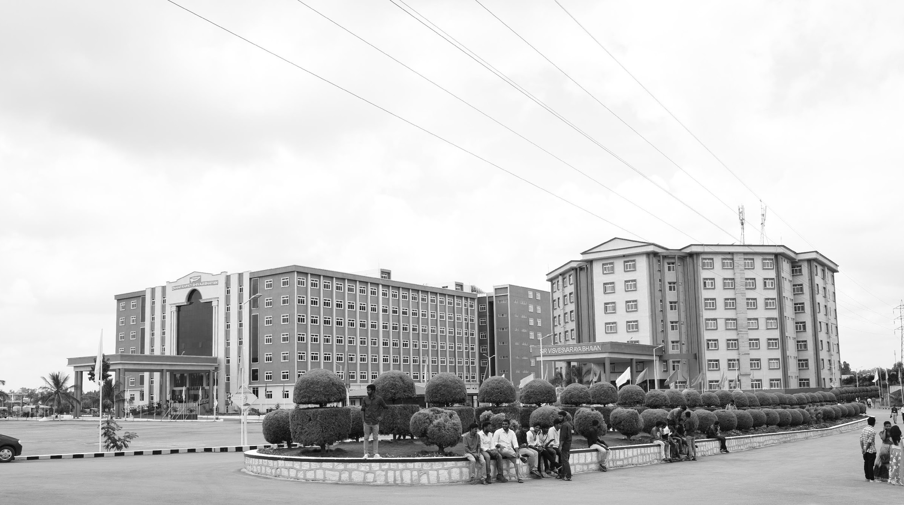

EMPOWERING SMART GRID FOR THE FUTURE OF URBAN CENTERS
AY 2021-25
GITAM UNIVERSITY
Capstone Project
Project ID: XX
A University should be a place of light, of liberty, and of learning.
Department of Electrical Electronics and Communication Engineering
Project Team:
AHMED
SIVA KUMAR
YASHWANTH
Project Mentor:
Dr P .SUNDARARAMAN
www.gitamedu.com

Slide 2

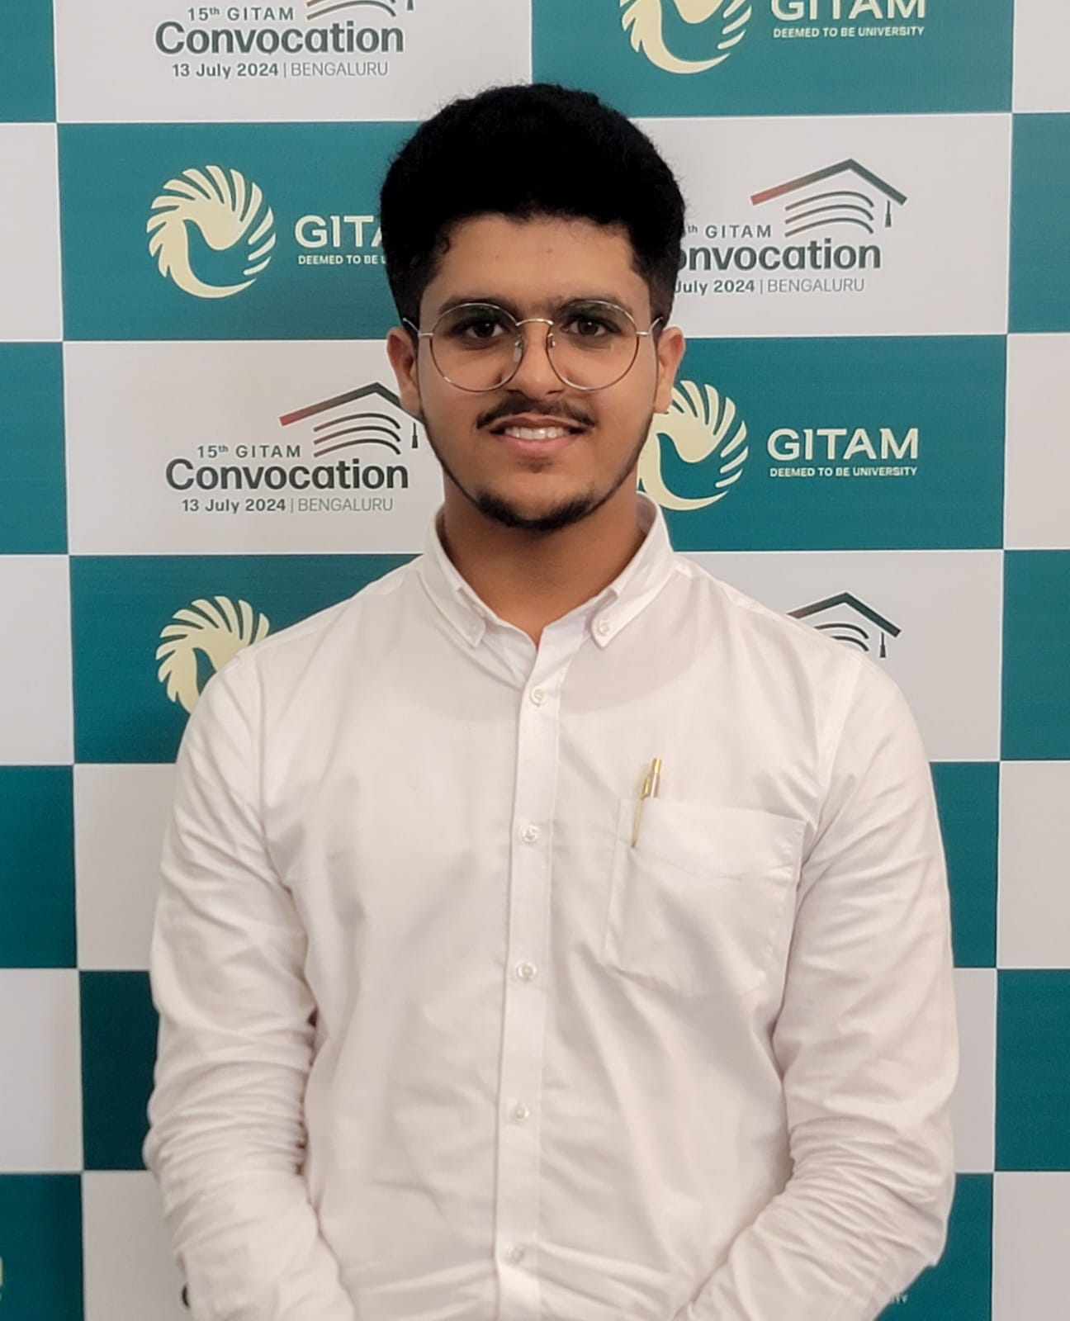

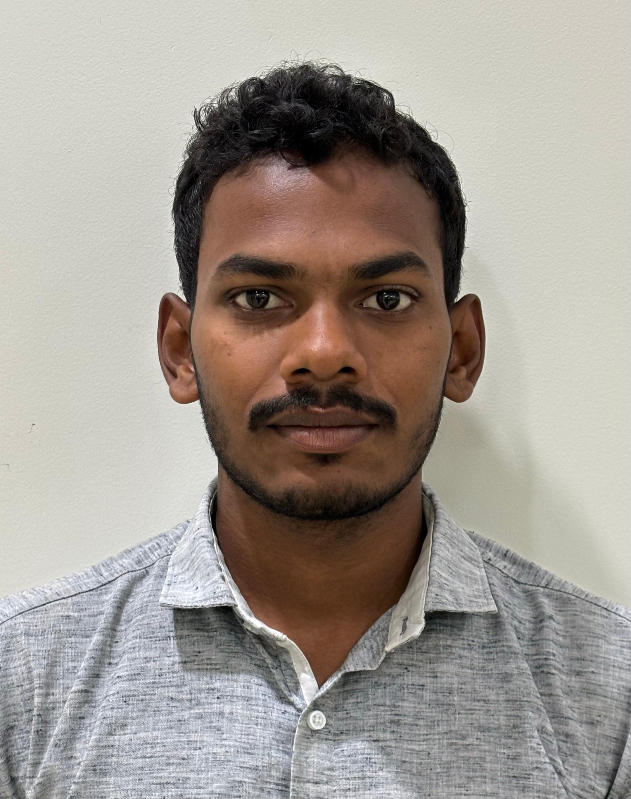
Project Group – Details
Photo
Track
Roll No
Name
EEE
BU21EECE0200026
AHMED ABDULRAHMAN ABDULLAH BIN ALFAQEEH
EEE
BU21EECE0200038
SEEPALA SIVA KUMAR
EEE
BU21EECE0200033
YASHWANTH M

Slide 3
Objective and Goals
Objectives
Implementing a scalable and flexible smart grid to support expanding urban centers.
Integrating different energy sources like solar and wind turbines to reduce dependency on fuel and lower carbon footprints in urban areas.
Integrating IoT technologies for better reliability and accelerating fault detection and two-way communications across the electric system of an area.
Real-time monitoring and control, enabling data-driven decision-making for enhanced energy management.
Goals
Main Goals
Enhance Grid Scalability and Flexibility
Improve Grid Reliability and Efficiency
Empower Real-Time Monitoring and Control
Additional Goals
Gain proficiency in multiple software platforms used for smart grid design, simulation, and analysis.
Learn how to effectively integrate and manage IoT devices within the smart grid to enhance monitoring.

Slide 4
Literature Survey
Key Publications
S.No | Article | Authors | Published on | Description
1 | Investigating the use of MATLAB/SIMULIK and LabVIEW in Microgrid Modelling and Simulation | Mahmoud Laban | 25 Aug 2017 | He has modeled and simulated a microgrid using MATLAB/and Simulink, but he did not integrate the IoT devices that enable 2-way communications.
2 | Recent advancement in smart grid technology: Future prospects | Osama Majeed Butt a, Muhammad Zulqarnain a , Tallal Majeed Butt | 7 July 2020 | Future research in smart grids focuses on improving forecasting, optimizing power flow, enhancing communication, integrating microgrids, managing energy demand, ensuring standards, scalability, cost-effectiveness, data security, and automating generation, transmission, and distribution.
3 | Solar power integration in Urban areas: A review of design innovations and efficiency enhancements | Emmanuel Augustine Etukudoh 1, Zamathula Queen Sikhakhane Nwokediegwu 2, Aniekan Akpan Umoh 3, Kenneth Ifeanyi Ibekwe 4, Valentine Ikenna Ilojianya 5 and Adedayo Adefemi | 16 Jan 2024 | Integrating IoT devices into the smart grid is the future trend in the structure of power systems, including the use of smart city technologies to optimize solar energy capture and grid reliability in urban environments.
4 | Modeling and Control for Smart Grid Integration of Solar/Wind Energy Conversion System | Emad Natsheh, Alhussein Albarbar, Javad Yazdani | ___________ | Novel model of a smart grid-connected PV/WT hybrid system, incorporating photovoltaic arrays, wind turbines, and control components, developed using MATLAB/SIMULINK. By utilizing real-time data and the Perturb and Observe (P&O) algorithm for maximum power point tracking (MPPT), the model demonstrates effective performance optimization and system reliability under various operating conditions.

Slide 5
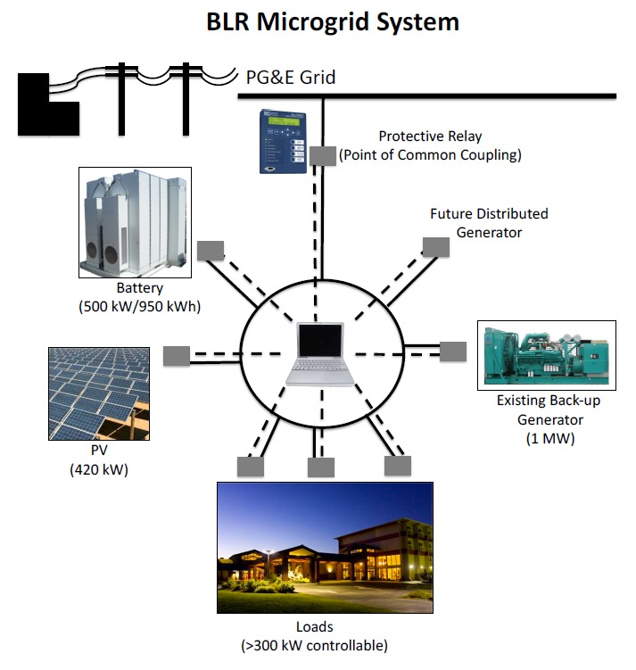
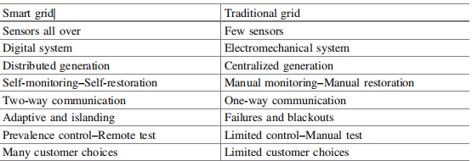
Existing Models:
Compression Between Smart Grid And Normal Grid
Key Resources:
Google Scholar

Slide 6
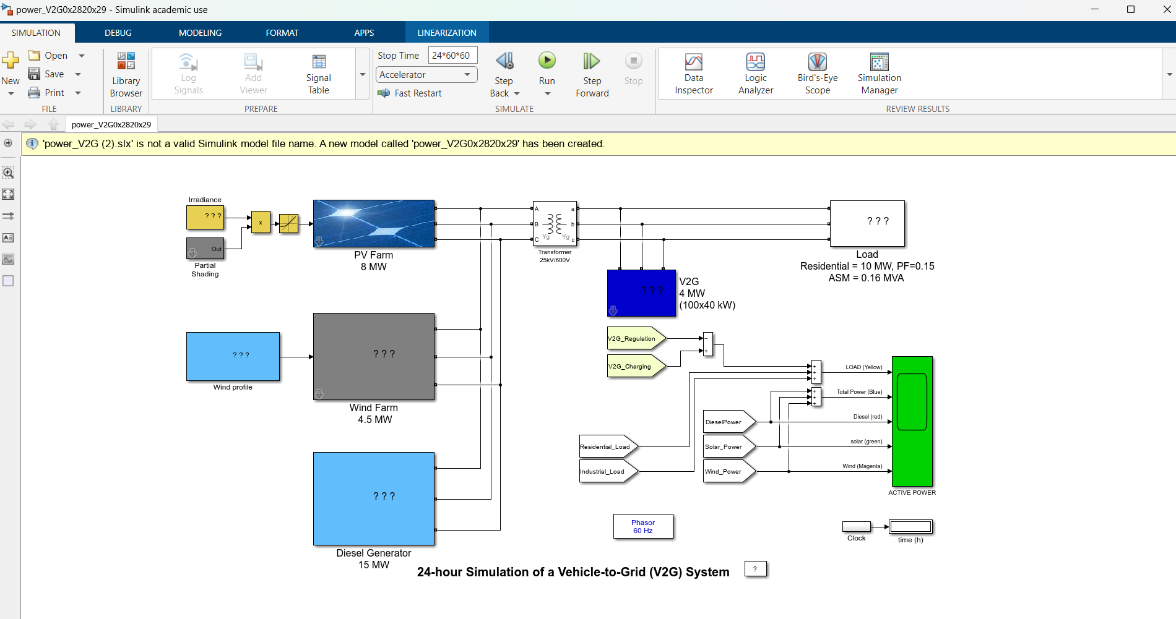
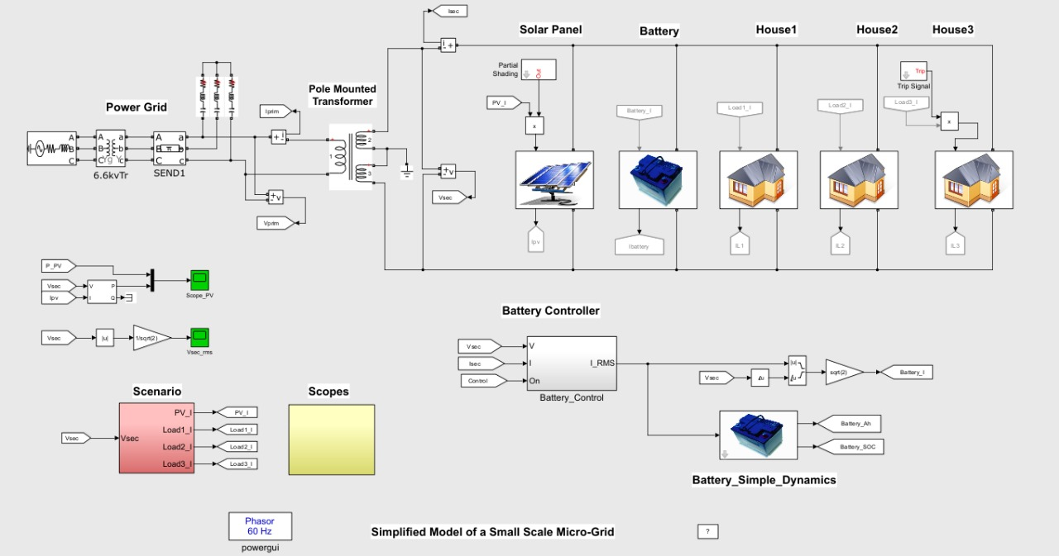

Slide 7
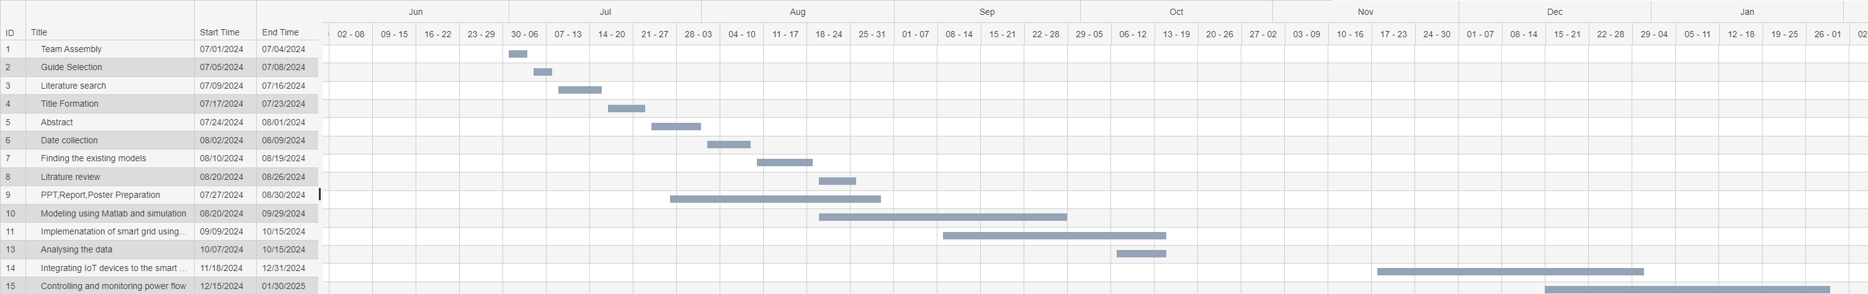
Project Plan

Slide 8
Analysis - SWOT
Strengths
Weaknesses
S1. High Efficiency
S2. Fast Fault Detection
S3. Energy saving
W1. High Capital Cost
W2. Dependency On Weather Conditions
W3. Complex Implementation
W4. Data Storage
Threats
T1. Cybersecurity Risks
T2. scarcity of components
Opportunities
O1. Integration Of Renewable Sources
02. Reduction Of Carbon Emission
O3. Support For Electric Vehicles
O4. Latest research areas

Slide 9
Analysis – 4W1H
What: A smart grid is an advanced electricity network using digital communication technology to optimize electricity distribution and consumption. It integrates renewable energy sources and improves reliability.
Why: Smart grids enhance power system efficiency, reliability, and sustainability by reducing transmission losses and improving grid security. They empower consumers to control energy use and enable utilities to respond swiftly to demand changes and disruptions.
Where: Smart grids are applied at various levels, including city, industrial, and rural areas. Our MATLAB model will simulate one of these implementations.
When: Smart grid optimization is crucial during peak demand, emergencies, or with variable renewable energy sources. It manages real-time energy distribution and consumption.
How: The project involves simulating power generation, transmission, and distribution in MATLAB using smart technologies like sensors, automation, and IoT for monitoring and optimizing grid performance.
Refined Objective: Develop a scalable smart grid integrating renewables and backup generators, focusing on IoT-driven monitoring and fast fault detection for reliable, efficient urban energy systems.

Slide 10
Architecture
Communication And Controlling Center
Generation
Consumer\Load
Residential
Solar Farm
Commercial
Wind Farm
Transmission
Distribution
Industrial
Backup Diesel Generator
Storge system
Power flow line
2-way communication and data flow line

Slide 11
Use Cases & Testing
Use Cases
1. Solar and Wind:
These renewable sources generate electricity based on real-time data (solar irradiance for solar panels and wind speed for wind turbines).
2. Backup Generator:
The diesel generator serves as a backup, activating automatically when renewable sources cannot meet demand.
3. Energy Storage:
The battery system stores excess energy produced by solar and wind, supplying it during periods of high demand.
4. Load Management:
As a smart grid, the system adjusts the distribution of energy from these sources according to real-time load requirements, ensuring efficient supply based on demand.
Test Cases
1. Using PLL Loop for PWM Generator:
Test synchronization with grid frequency and stability under disturbances.
2. Different Environmental Conditions for Renewable Sources:
Test power output variability with changing solar irradiance, temperature, and wind speeds.
3. Different Types of Loads:
Test grid response with inductive, capacitive, and resistive loads for power balance.
4. Grid Fault Condition Testing:
Simulate faults (e.g., short circuits) to check fault detection and recovery

Slide 12
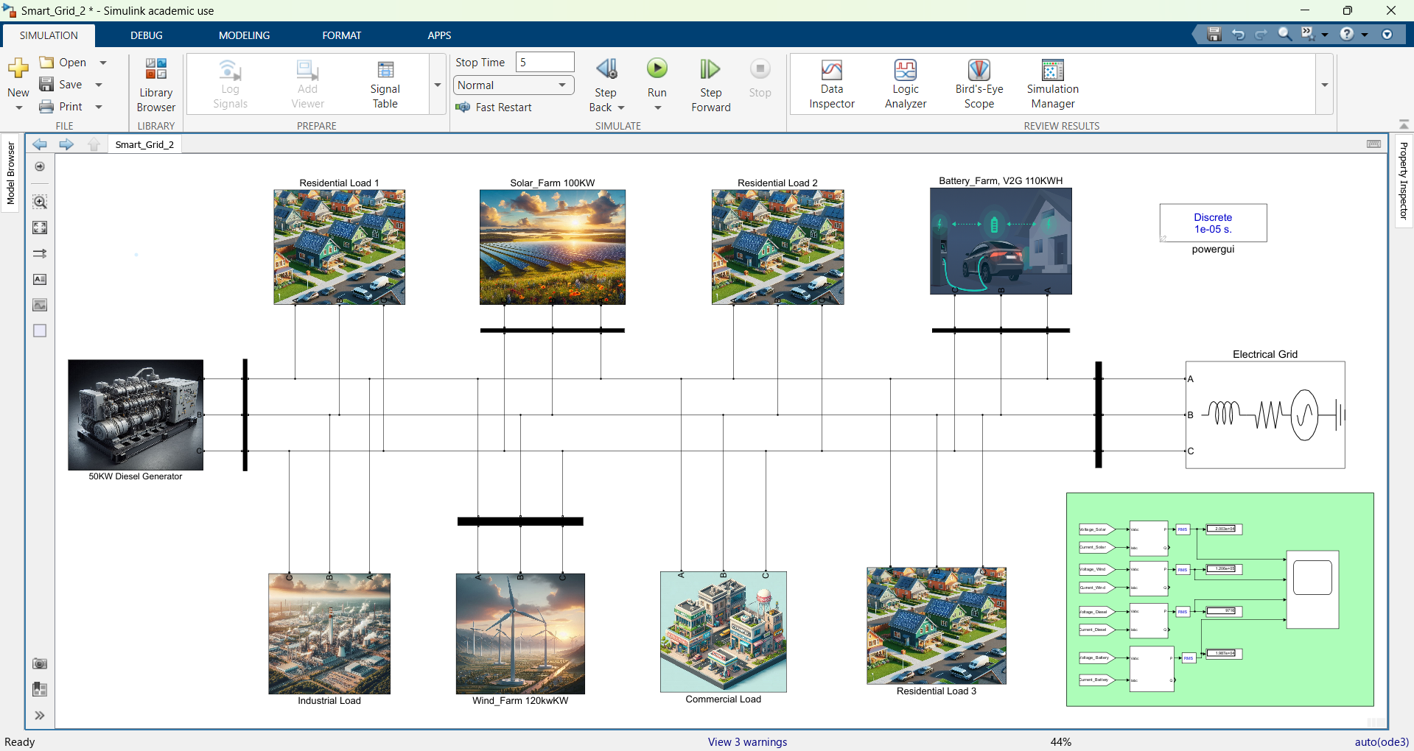
Implementation and Results
Results
MATLAB Implementation
Total System Capacity: 380 kW
Solar Farm: 100 kW
Wind Farm: 120 kW
Diesel Generator: 50 kW
Battery Storage: 110 kWh
Total Load: 285 kW (Residential, Commercial, Industrial)

Slide 13
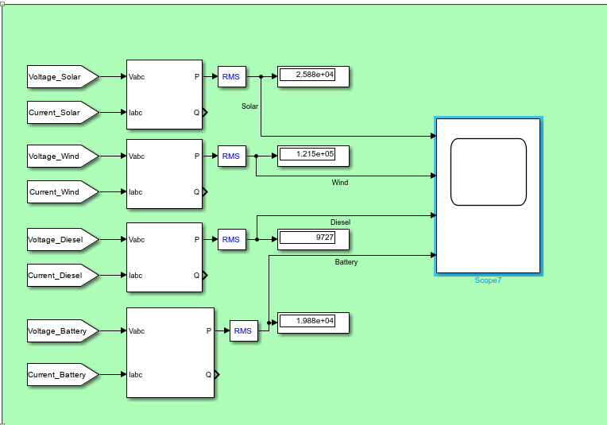
Output power

Slide 14
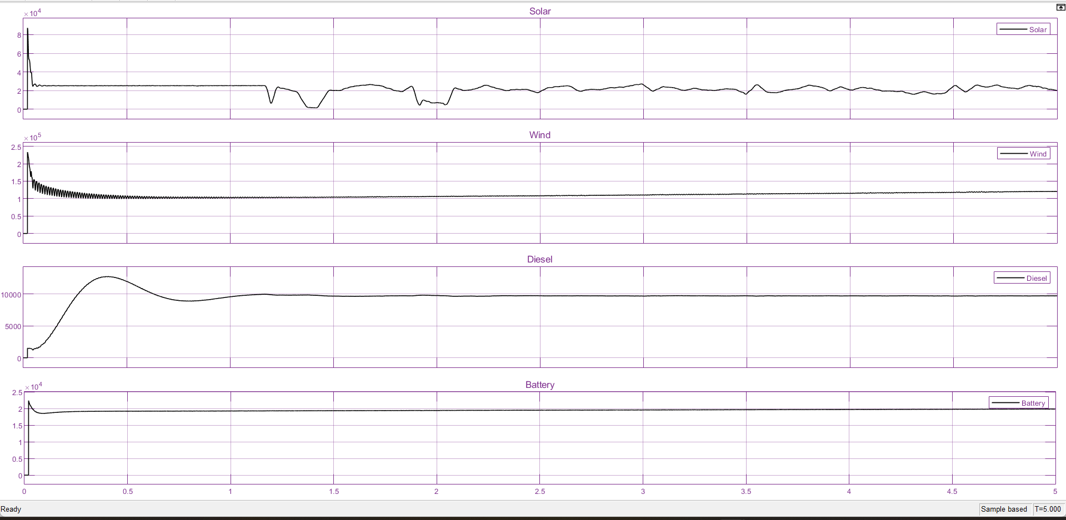
Output Graph Results
In our project, we integrated four power sources: a solar farm providing 20%, a wind farm at 100% capacity, a diesel generator at 20%, and battery storage also at 20%. While the total output meets load demands, some imbalance exists due to the lack of a sophisticated control system. Unlike existing technologies that focus on direct current and voltage measurements, our approach implemented each subsystem individually before integration, resulting in a comprehensive design. Future phases will develop a control system to improve efficiency, while the solar and wind farms dynamically adjust outputs based on real-time data.

Slide 15
Contribution
Team Progress and Movement
Literature review
Abstract
Studying the existing models
Data collection
Gant chart
MATLAB modeling and designing
Individual Contribution
Key contributions: Ahmed
Team leader
MATLAB designing and modelling
Data importing and uploading
Design arrangement
Key contributions: Siva Kumar
MATLAB designing and modelling
Testing and verification of MATLAB models
Key contributions: Yashwanth M
Designing energy storage system in MATLAB.
Gant chart creation and project documentation.

Slide 16
Conclusion & Future Work
Summary and Conclusion
In this project, we successfully designed and integrated a hybrid energy system that includes a solar farm, wind farm, diesel generator, and battery storage system. The solar farm operates based on solar irradiance and temperature data, while the wind farm functions using wind speed data. These energy sources were connected to different types of loads (resistive, capacitive, and inductive), and circuit breakers were incorporated for system protection and control some imbalance exists due to the lack of a sophisticated control system.
Future Work
In the future, IoT devices will be integrated into the system for enhanced real-time monitoring and remote control. This will enable better supervision, data collection, and optimization of the system's overall performance. The next phase will focus on improving the automation and reliability of the hybrid energy system for real-world applications in urban centers.

Slide 17
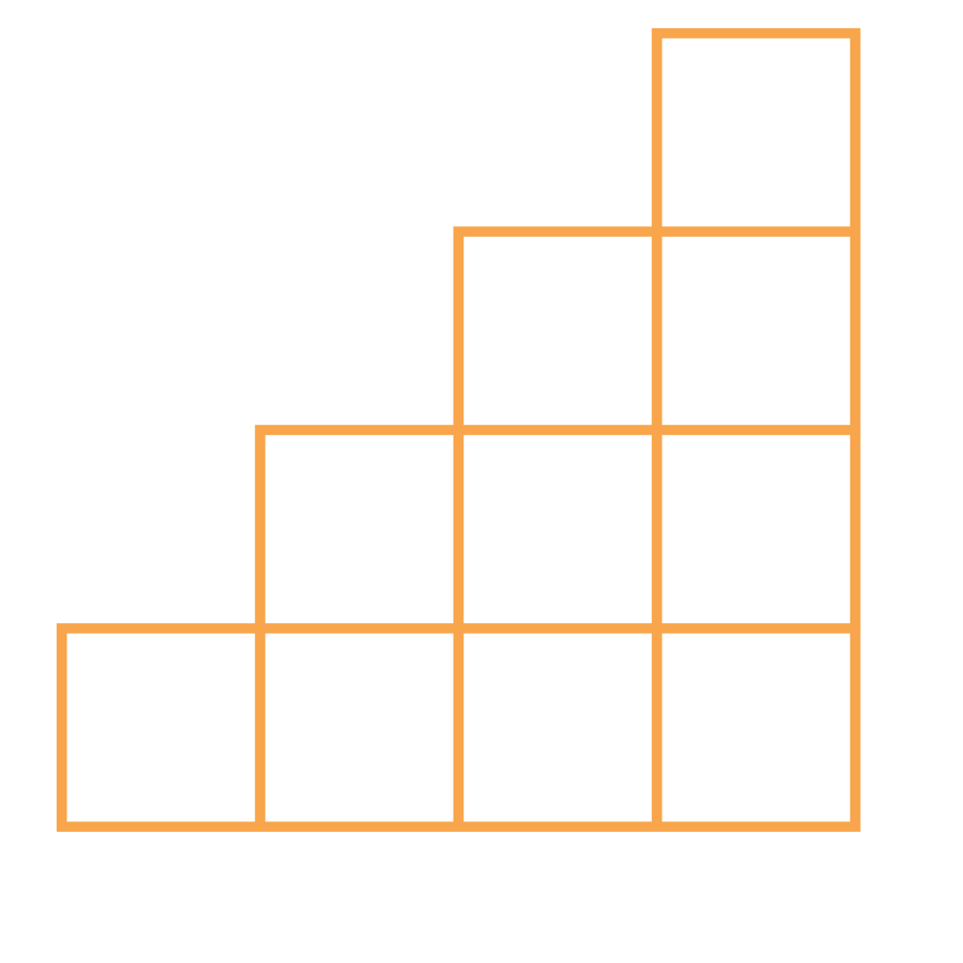
THANK YOU

